Slide 1
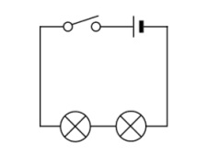

Circuits
Is your work well presented?
Lesson Objectives
1. Identify circuit symbols used in a circuit.
2. Explain what current and potential difference are.
3. Construct circuit diagrams using standard symbols.

Slide 2

What do the symbols in this circuit represent?
Achieving Objective 1 - Identify circuit symbols used in a circuit
Review
What have we found out?
Is your work well presented?

Slide 3





Can you match the symbols to its component?
Achieving Objective 1 - Identify circuit symbols used in a circuit
Bulb
Variable resistor
Thermistor
Battery
Fuse

Slide 4
So what is current? What is it measured in?
Achieving Objective 2 - Explain what current and potential difference are.
Current
Current is a measure of how much electrical charge flows through a circuit. The more charge that flows, the bigger the current.
Current is measured in units called amps. The symbol for amps is A.
Review
What have we found out?
Is your work well presented?

Slide 5
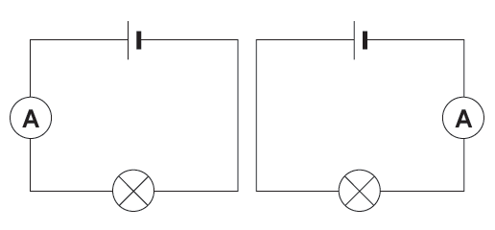
Measuring current in a circuit. How is it done?
Achieving Objective 2 - Explain what current and potential difference are.
Measuring current
A device called an ammeter is used to measure current.
To measure the current flowing through a component in a circuit, you must connect the ammeter in series with it.
Review
What have we found out?
Is your work well presented?

Slide 6
So what is potential difference? What is it measured in?
Achieving Objective 2 - Explain what current and potential difference are.
Potential difference
A potential difference (voltage), across an electrical component gives the energy needed to make a current flow through it. Cells or batteries often provide the potential difference needed.
Potential difference is measured in units called Volts. The symbol for volts is V.
Review
What have we found out?
Is your work well presented?

Slide 7
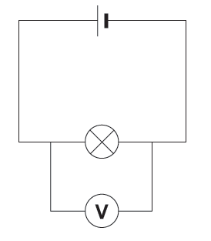
Measuring potential difference in a circuit. How is it done?
Achieving Objective 2 - Explain what current and potential difference are.
Measuring voltage
Voltage is measured using a voltmeter.
To measure the voltage across a component in a circuit, you must connect the voltmeter in parallel with it.
Review
What have we found out?
Is your work well presented?

Slide 8
Achieving Objective 3 - 3. Construct circuit diagrams using standard symbols.
Draw the circuit diagram (make if circuits available):
One bulb, one cell and a closed switch
Two bulbs, two cells and a open switch.
Two cells, an open switch, a bulb and a buzzer.
Review
What have we found out?
Is your work well presented?

Slide 9

Keywords and phrases from this lesson:
Highlight the words that you have used to day
Current
Potential difference
Circuit

Slide 10

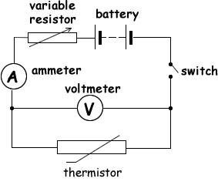
Plenary
Name those symbols.
A
B
D
C
E
F
Lesson Objectives
1. Identify circuit symbols used in a circuit.
2. Explain what current and potential difference are.
3. Construct circuit diagrams using standard symbols.
Review
What have we found out?
Is your work well presented?

